Slide 1
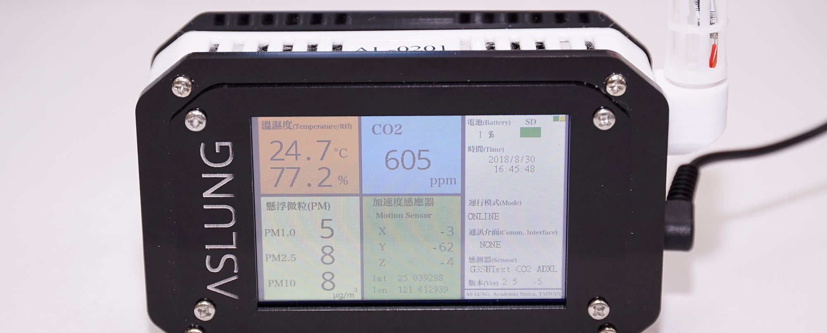
Advanced Institute on Health Investigation and Air Sensing for Asian Pollution (AI on Hi-ASAP)
Chun-Hu Liu 2020/10/05

Slide 2
Outline
Get calibration factor from reference instrument
Rational of calefaction factor
How to run python code to set calibration factor
Data cleaning
What data cleaning tasks need to be done
How to run python code to do data cleaning

Slide 3
Get calibration factor from reference instrument

Slide 4
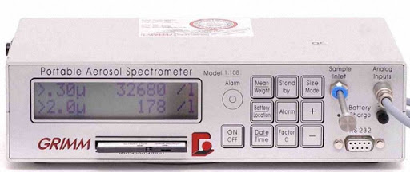
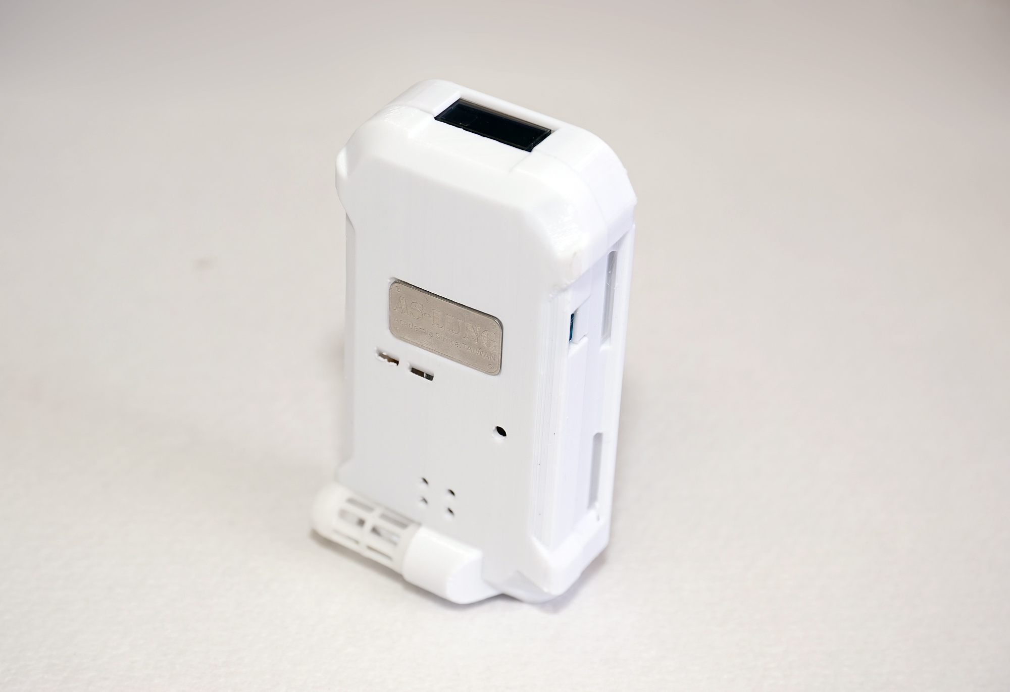
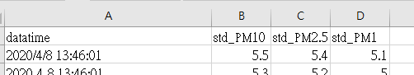
Rationale of calibration factor
1.AS-Lung compare with reference instrument
3.Rename the column name to fit the python code
Data format of AS-Lung
Do not modify the data format of AL-Lung
Data format of reference instrument
Rename the column name of time and PM
Modify the data time format of time column
Reference instrument
AS-Lung
2.Rename the filename to fit the python code
Rename the filename of AS-Lung
Ex: 2020-09-27.csv ➔AL-0001_2020-09-27.csv
The filename should be contain AS-Lung ID
(AL-0001 or AL0001)
IMPORTANT
Column name and data time format of should be the same as the figure
Rename the filename of reference standard
Ex: Grimm026.xls ➔standard_Grimm026.xls
The filename should be contain “standard”
and with excel data file

Slide 5
Rationale of calibration factor
AS-Lung compare with reference instrument
Calibration factor
Factors of PM₁ and PM_{2.5} will be reported since PM10 of G3 sensor is not reliable.
Select regression model
Simple linear regression or Two segments regression
Reference instrument
AS-Lung
Rename the filename to fit the python code
Rename the column name to fit the
python code
Rename the filename of AS-Lung
Ex: 2020-09-27.csv ➔AL-0001_2020-09-27.csv
The filename should be contain AS-Lung ID
(AL-0001 or AL0001)
Data format of AS-Lung
Do not modify the data format of AL-Lung
Data format of reference instrument
Rename the column name of time and PM
Modify the data time format of time column
Rename the filename of reference standard
Ex: Grimm026.xls ➔standard_Grimm026.xls
The filename should be contain “standard”
and with excel data file

Slide 6
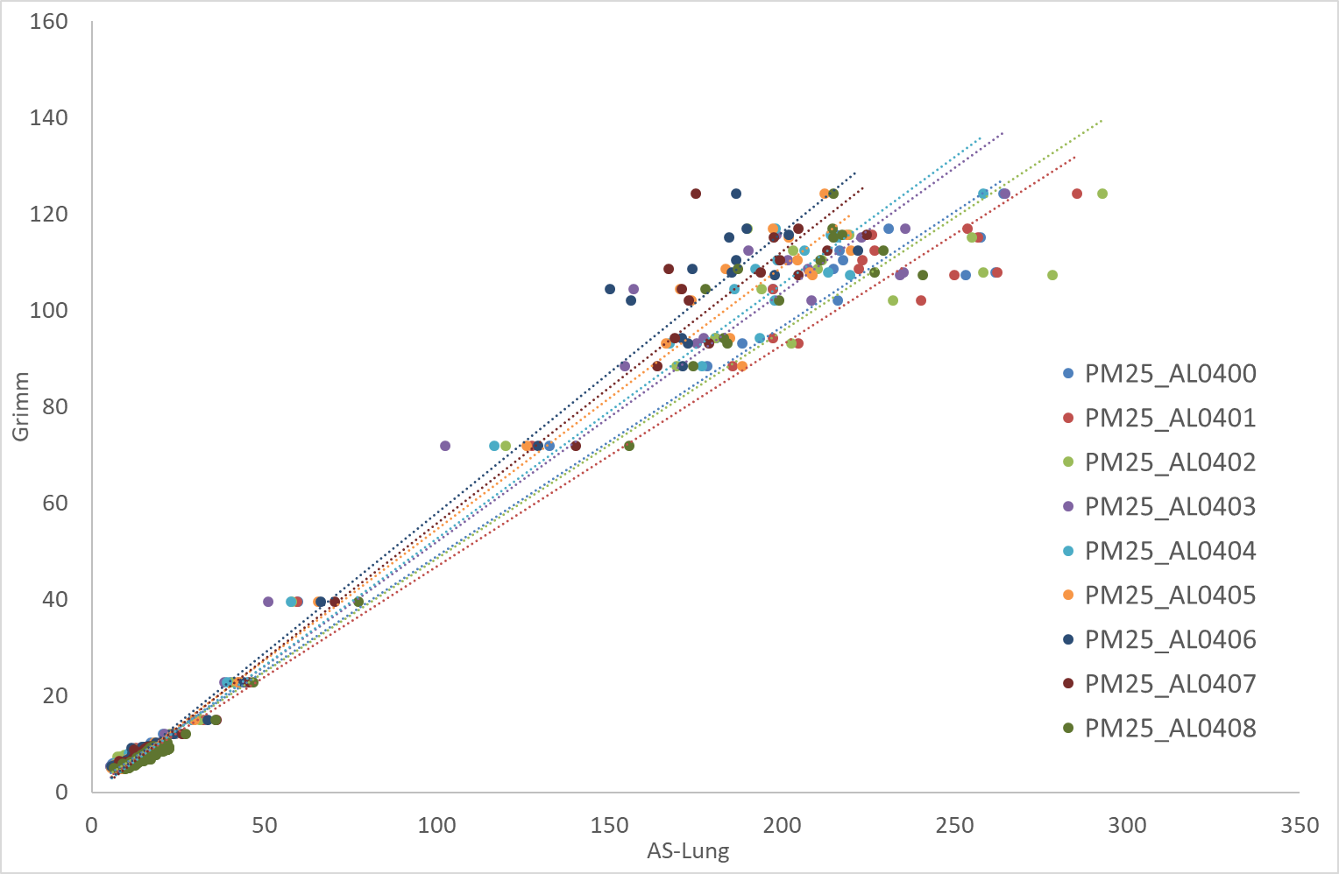
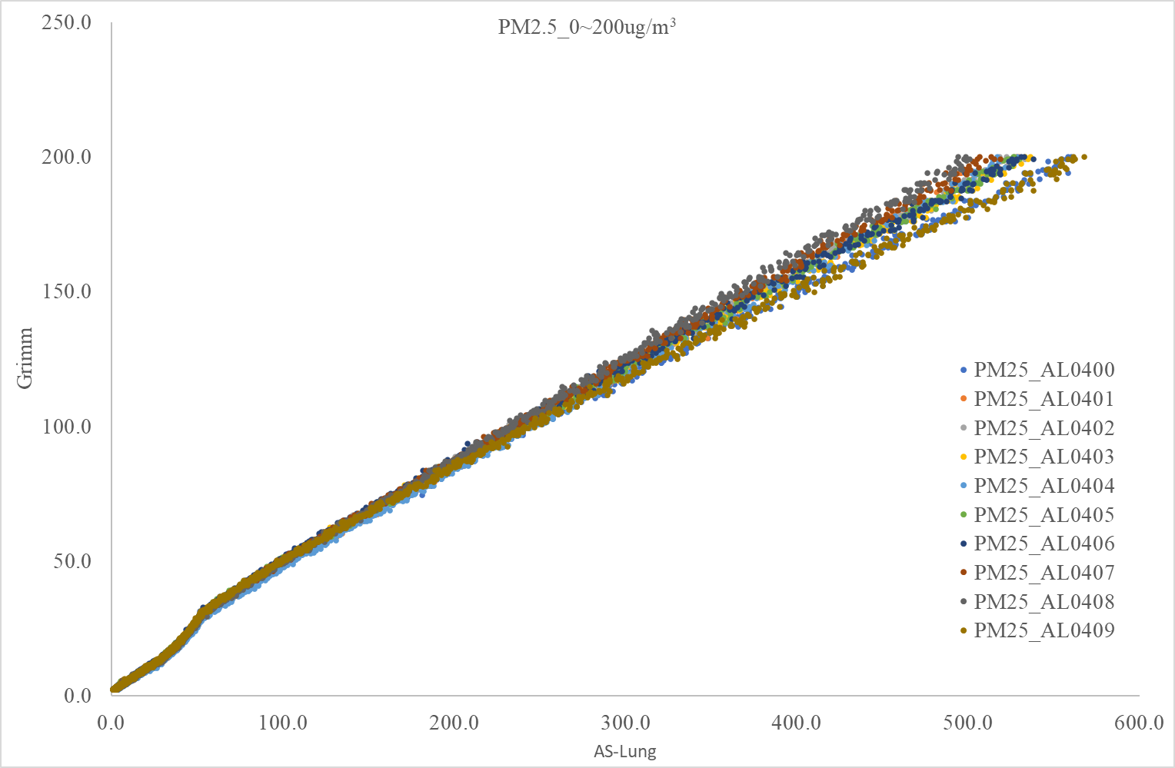
Regression model
Simple linear regression
Two segments regression
Breaking point
When run the python code, we can select regression model.

Slide 7
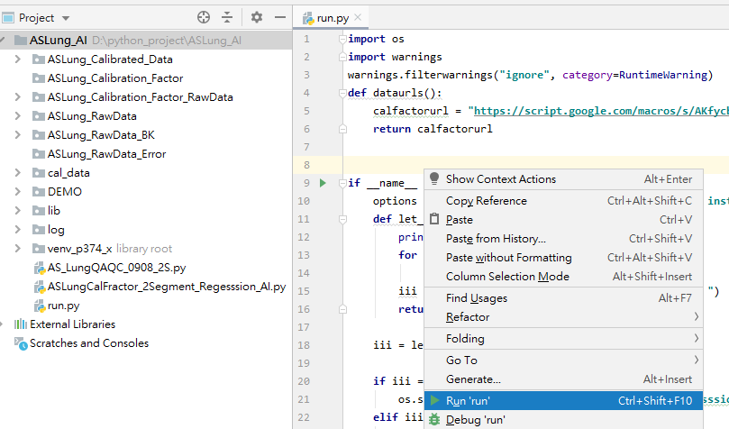
How to run the Python Code (1)
1. Open PyCharm -> project -> run.py
Step 1:
Copy raw data to the folder of “ASLung_Calibration_Factor_RawData”
Step 2:
Open run.py (double click)
Step 3:
Run the python code
Step 1
Step 2
Step 3

Slide 8
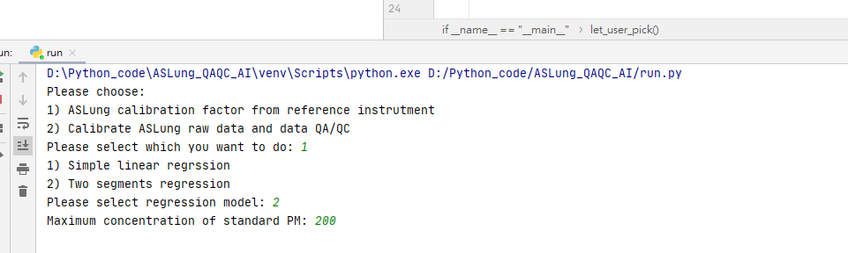
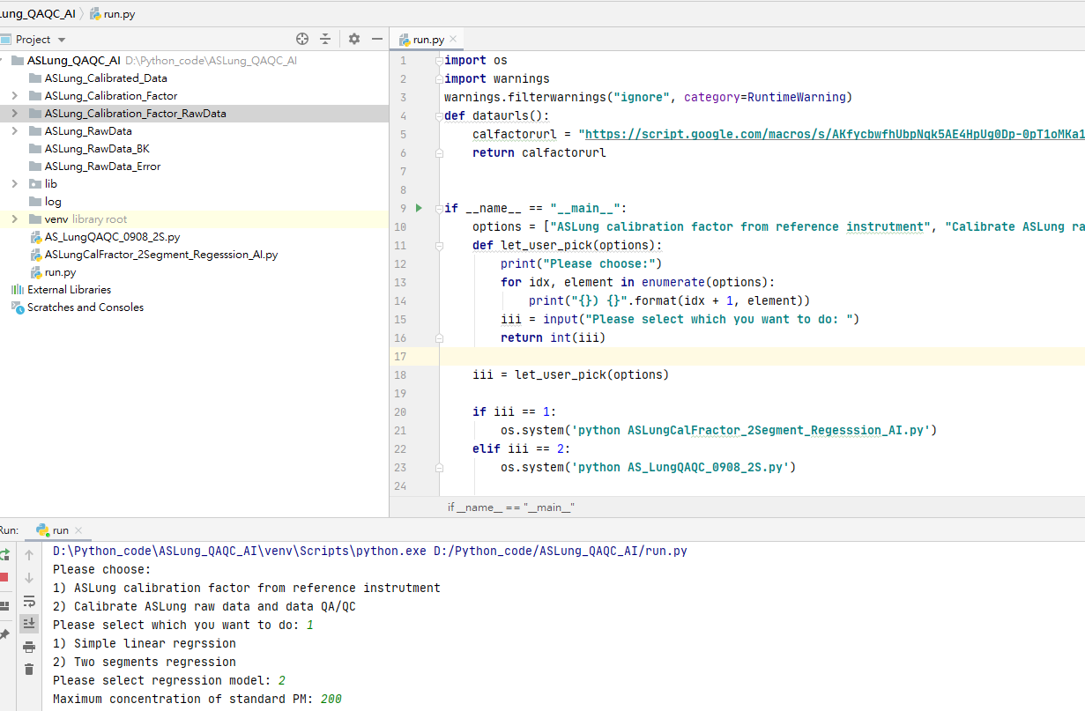
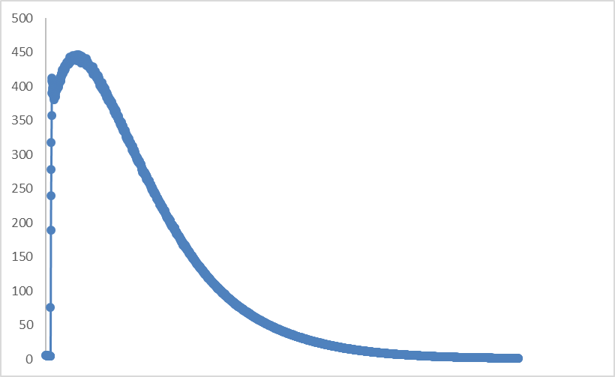
How to run the Python Code (2)
2. Select 1) ASLung calibration factor from reference instrument to run the python code
3. Select Regression model and input PM value after “Maximum concentration of standard PM”
4. The python code will automatically average data to 1 minutes.
5. The python code also select the calibration range from 1 to max value of input after the maximum value of the data set
3.1 Maximum concentration of standard PM is the highest concentration of the regression.
3.2 We use 200 (chamber) or 150 (hood) as maximum value.
3.2 If max value is 200, the calibration range is from 1 to 200.
Notes:
The select window is below the python code window

Slide 9
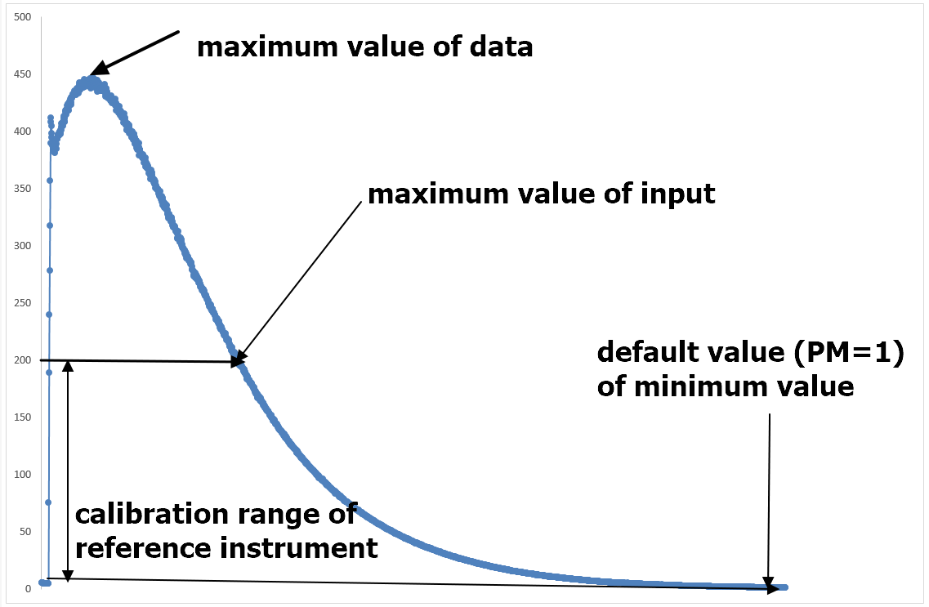
How to run the Python Code (2)
Notes:
The select window is below the python code window

Slide 10
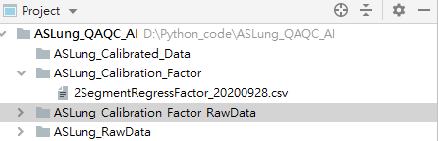
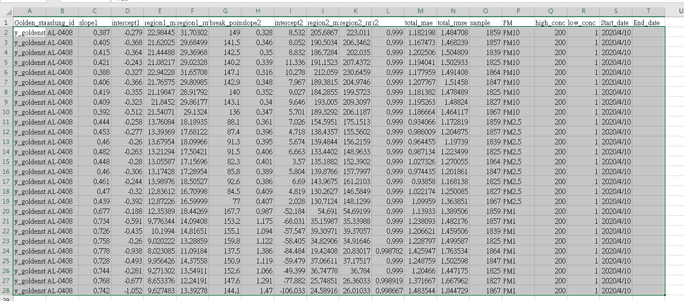
How to run the Python Code (3)
6. When finish, the file will be save in the folder of “ASLung_Calibration_Factor “
7. Open the file, copy the calibration factor and past them to the google sheet.
This google sheet only for demo and course, all the research group has individual google sheet
https://docs.google.com/spreadsheets/d/1yuvjPvsr1sEzm_pXpZWpnMxEC3WbsKn65V-apohp86E/edit#gid=0
The format between csv file and google sheet are the same, DONOT change the data format
Notes:
The select window is below the python code window

Slide 11
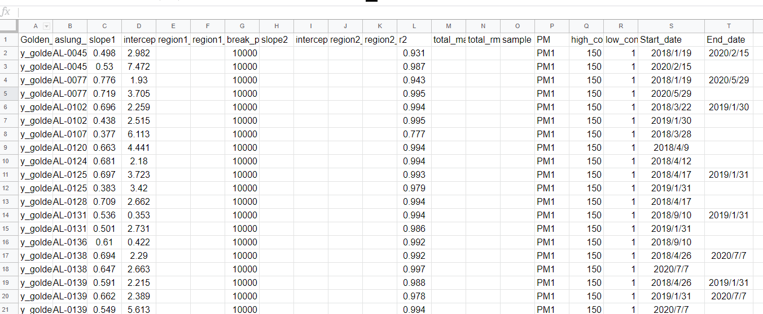
Google sheet
If you renew the calibration factor, please key in the end date in the “End_date” column.
Add a new row to add new calibration factor, DO NOT replace the old factor

Slide 12
Data cleaning

Slide 13
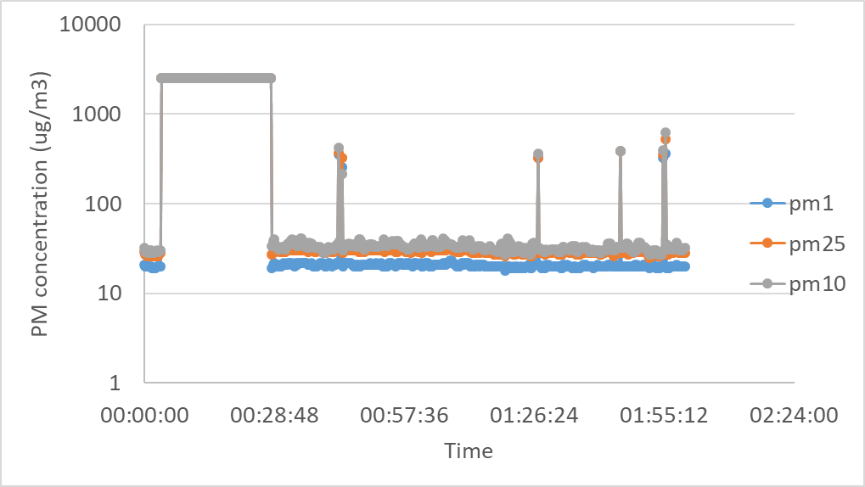
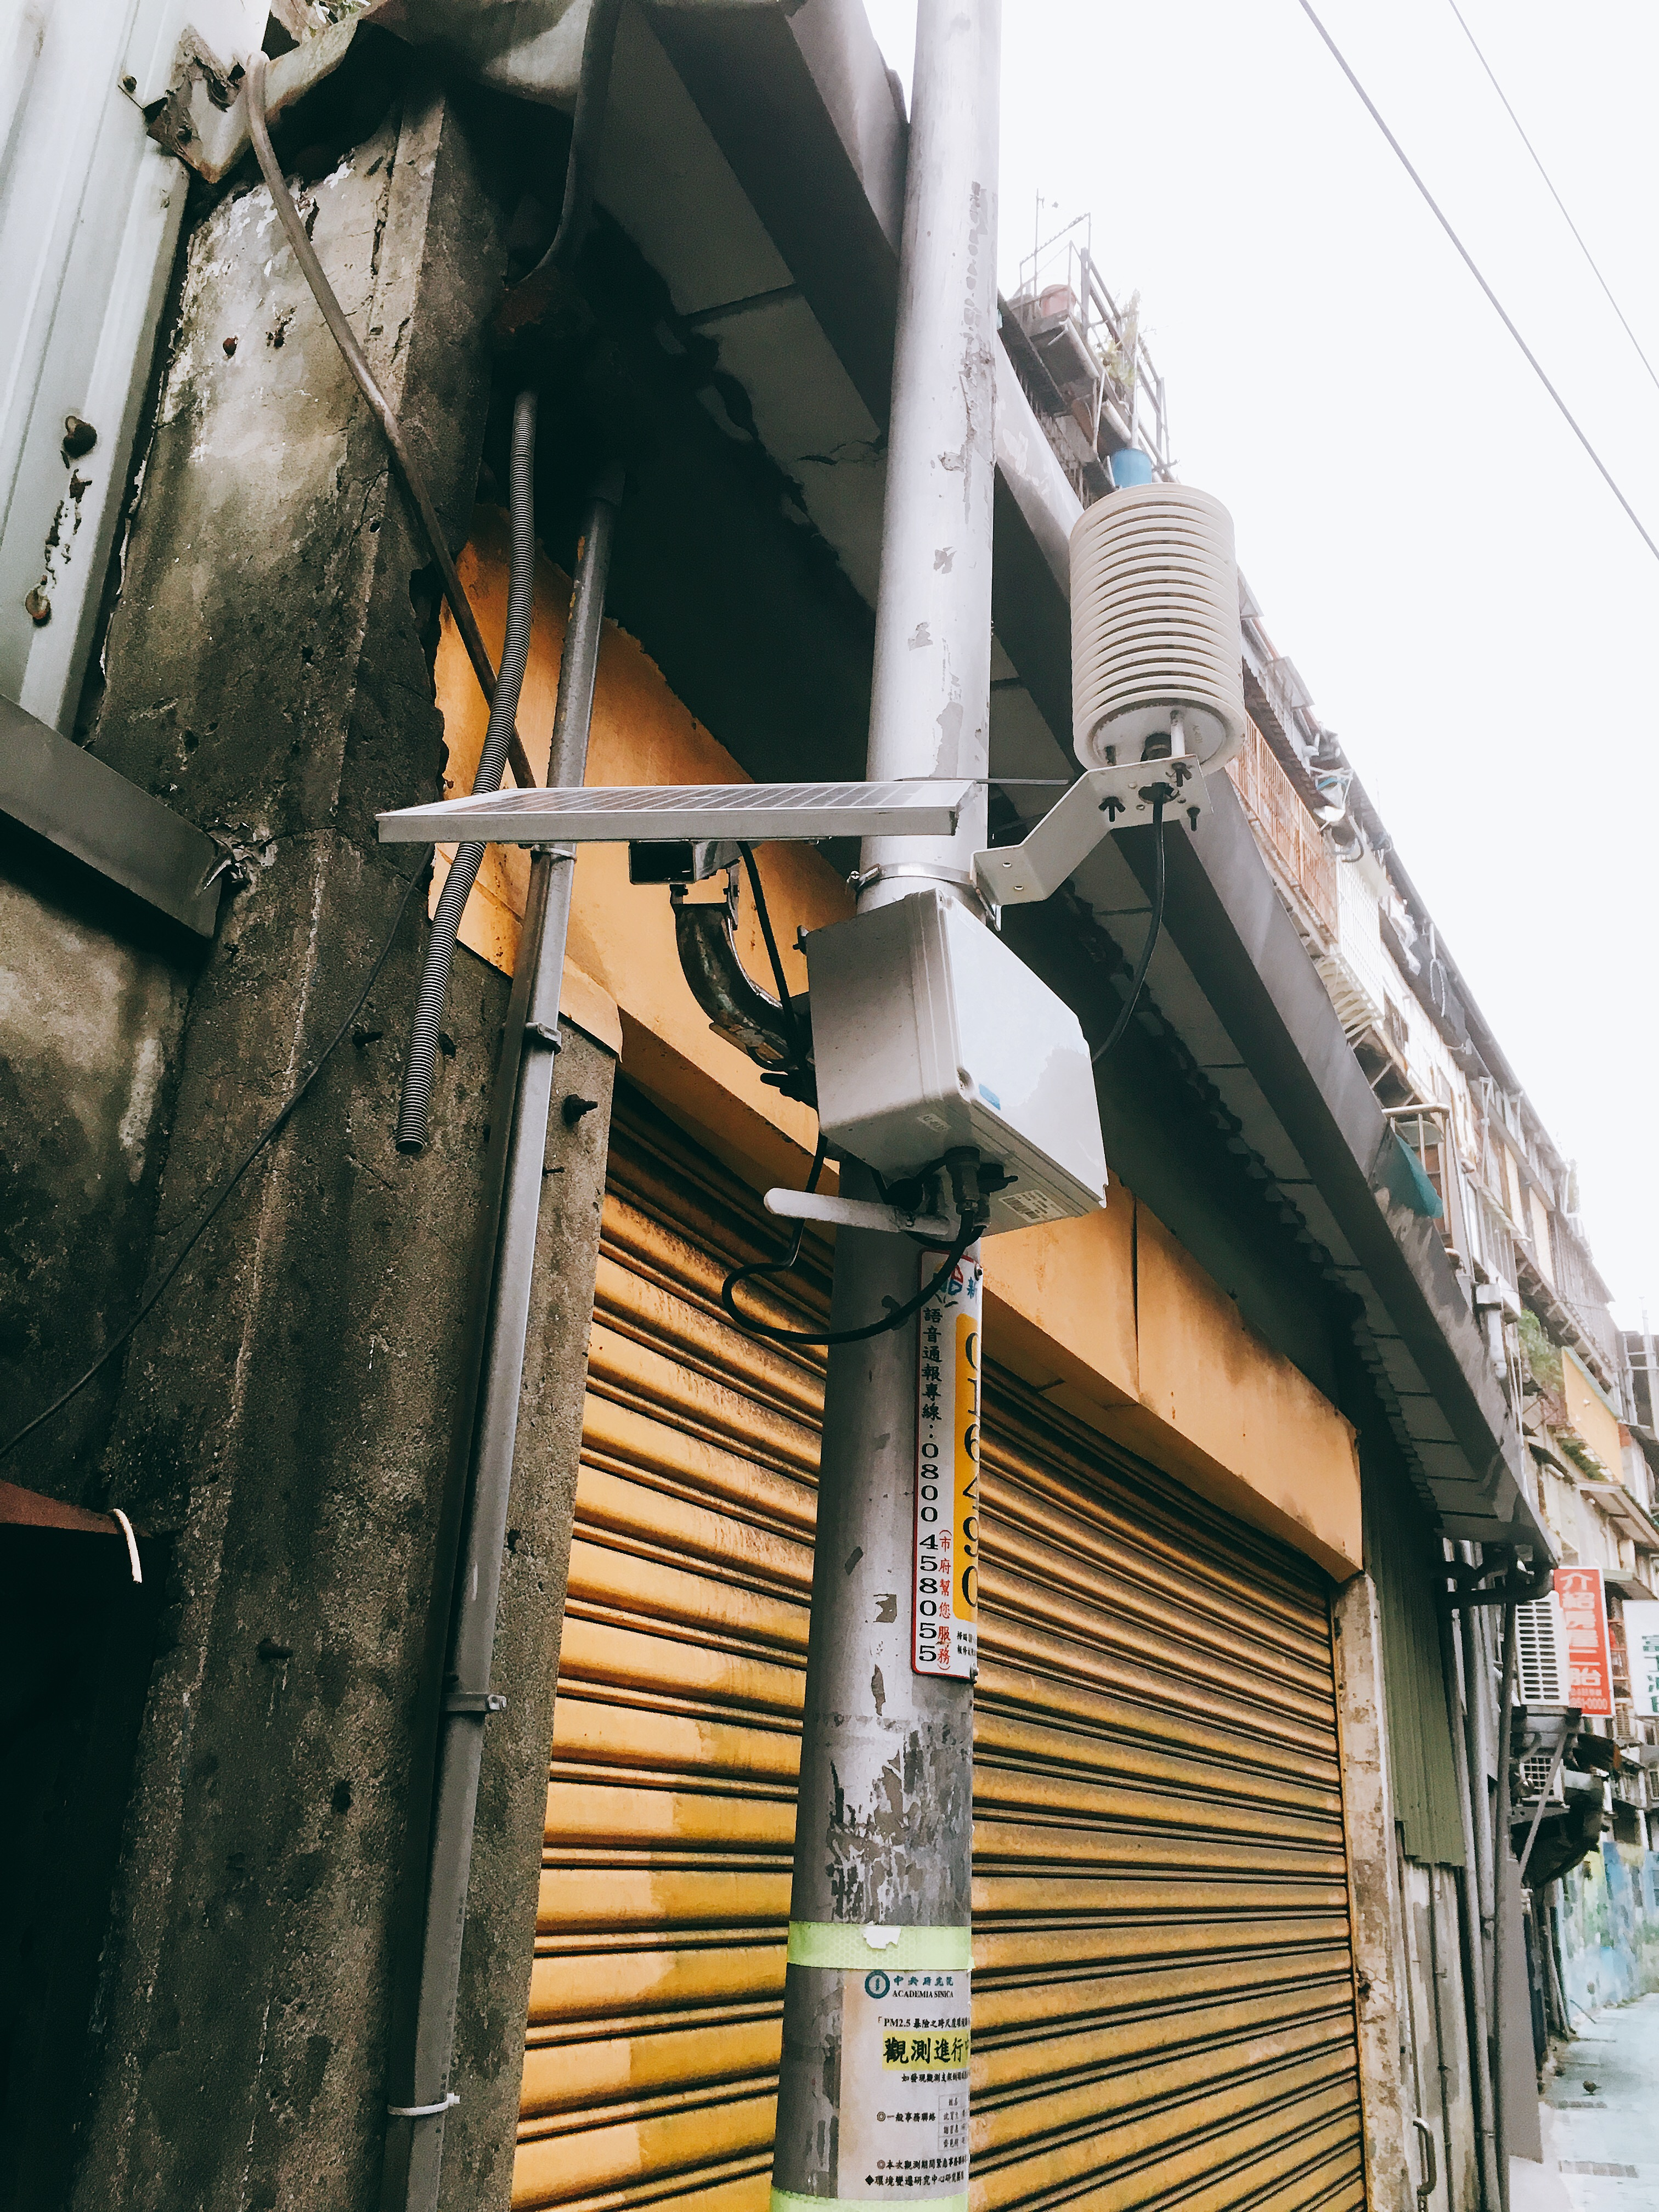
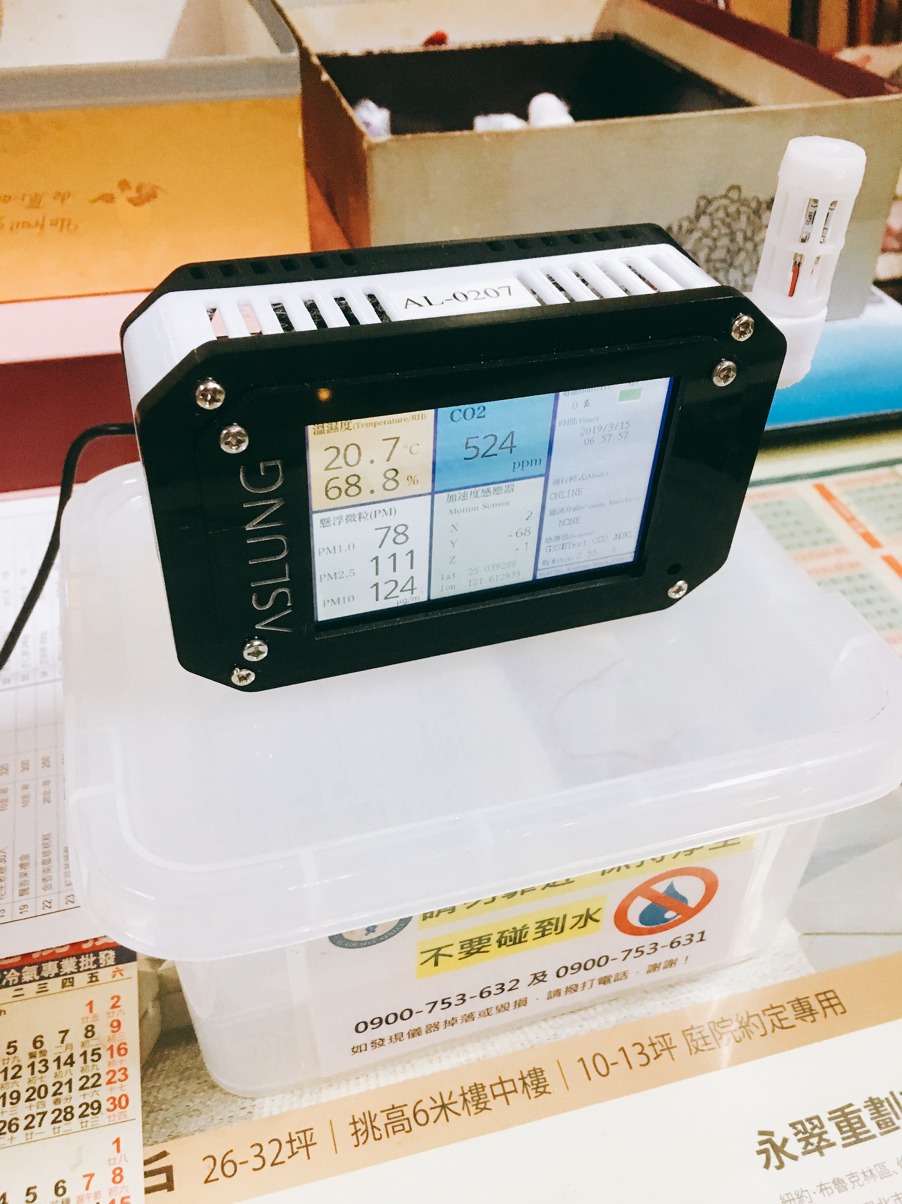
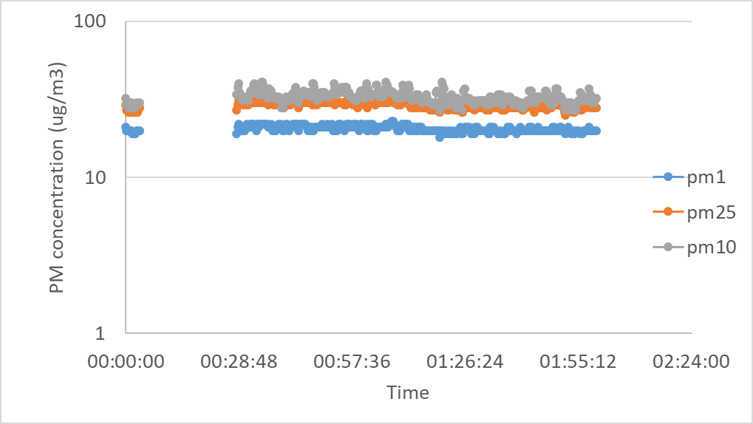
What data cleaning tasks need to be done
AS-Lung monitoring data
Before
There are two ways toe get raw data
1.data in SD card or 2.Data from database
Data cleaning criteria
After
Step of data cleaning
PM < 1
PM > 50 and PM1=PM2.5=PM10
Remove ghost peak
Set PM value as NaN
NaN is equal null

Slide 14
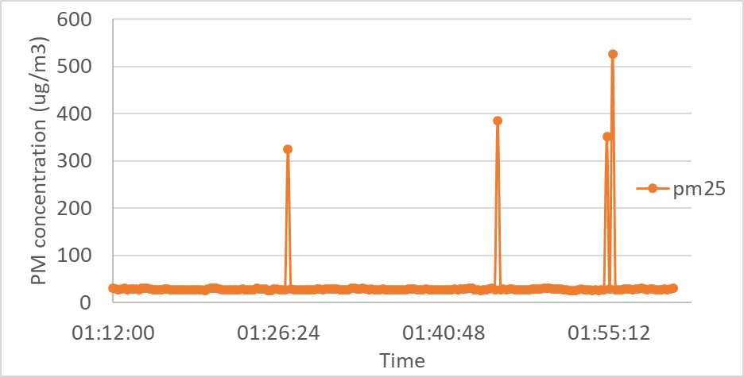
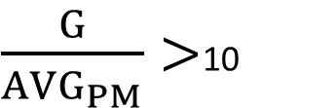
Remove ghost peak
Average PM (AVGPM) of the 5 data before or after the ghost peak
$\frac{G}{{AVG}_{PM}}>$10
Ghost peak (G)

Slide 15
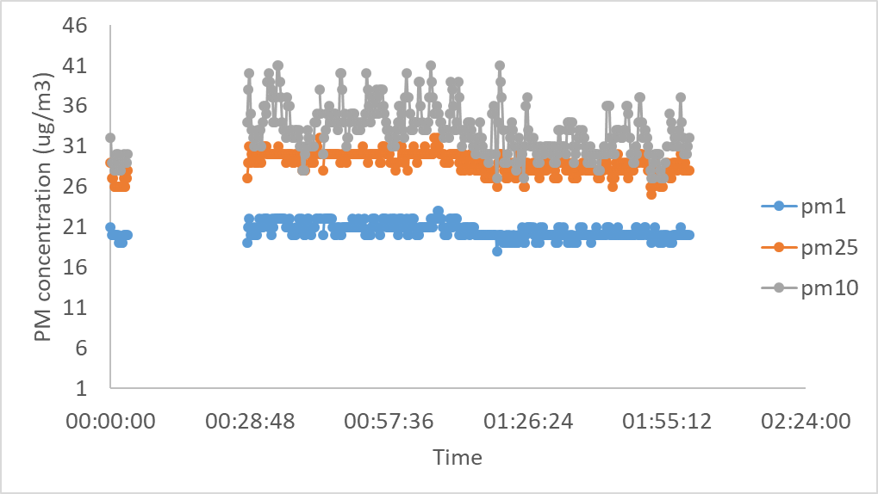
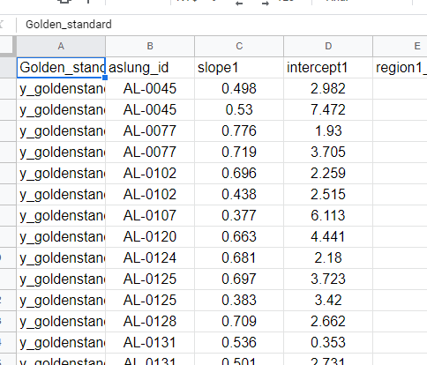
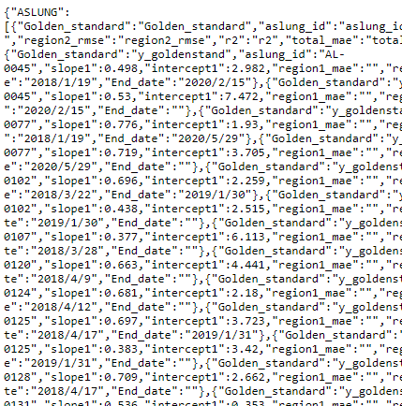
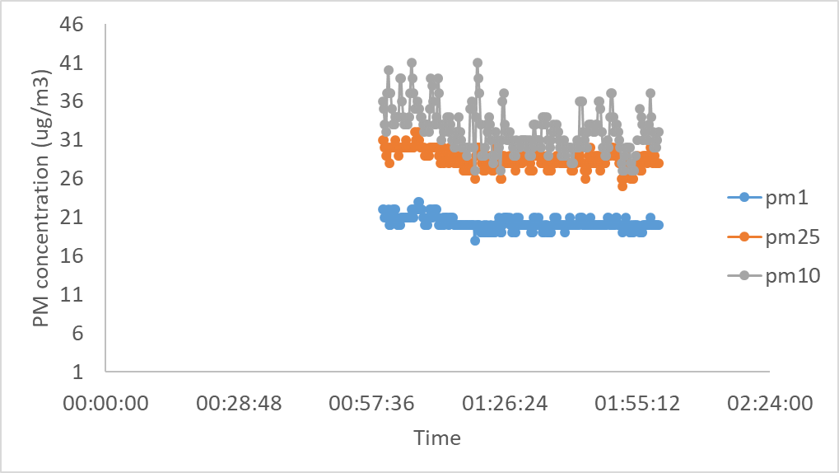
What data cleaning tasks need to be done
4. Remove data of temperature, humidity
and CO2 when values are less than 1
5. Get calibration factor from google drive
and calibrate AS-Lung data
6. If calibrated PM₁ > PM_{2.5}, PM₁ = PM_{2.5}
7. If the missing data is more than 1/3 in an
hour, the python code will auto remove all
the data in the hour
Before
IMPORTANT
Do not modified the format of the google sheet
After
Calibration factor in google sheet
Calibration factor API from google sheet

Slide 16
Google sheet

Slide 17
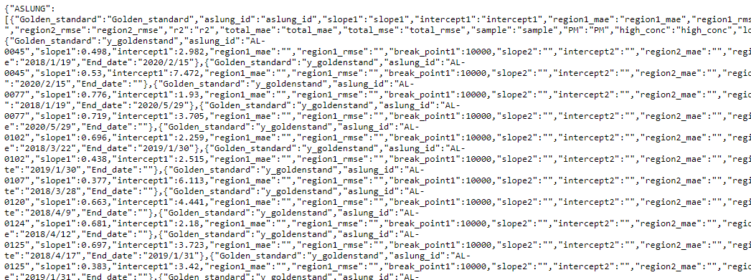
Calibration factor API
https://script.google.com/macros/s/AKfycbwfhUbpNqk5AE4HpUg0Dp-0pT1oMKa1mxLzWWAXb3dlnhTYRN8/exec
We create calibration factor API from google sheet. Keep the format of the google sheet is very important.

Slide 18
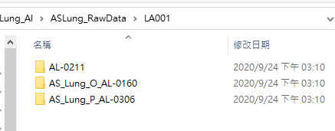
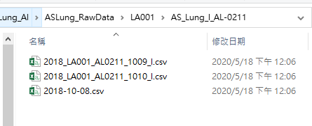
Data prepare
1.Folder name of the data set should be contain AS-Lung ID, EX:AL-0001
2.Rename the filename is optional
AS-Lung ID only
Or
Lab ID before AS-Lung ID , separate by “_”
Keep the original filename
Or
Rename the filename
it is optional

Slide 19
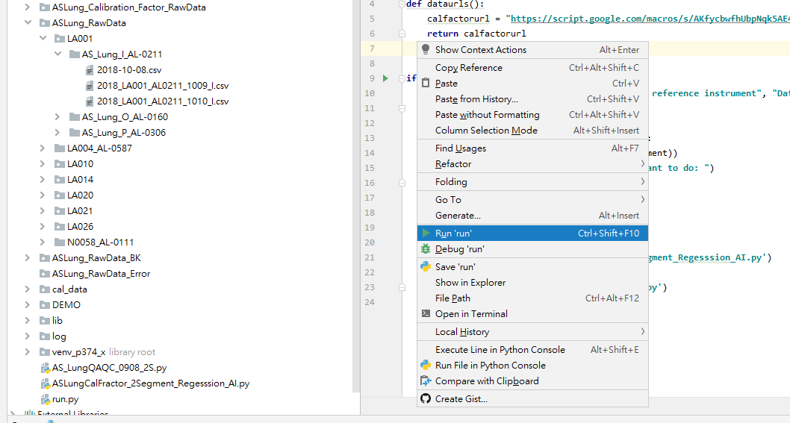
How to run data cleaning
Step 1:
Copy raw data to the folder of “ASLung_RawData”
Step 2:
Open run.py (double click)
Step 3:
Run the python code
3. Open PyCharm -> project -> run.py
Step 1
Step 3
Step 2

Slide 20
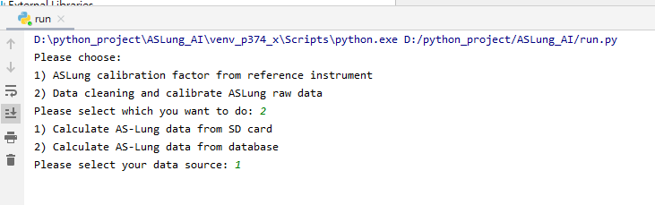
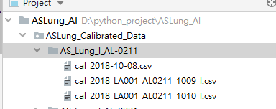
How to run data cleaning
4. Select 2) Data cleaning and calibrate ASLung raw data
5. Select your data source, SD card or database
6 . Calibrated data will be save in the folder of
“ASLung_Calibrated_Data”, the filename will add prefix of “cal_”
in the front of original filename

Slide 21
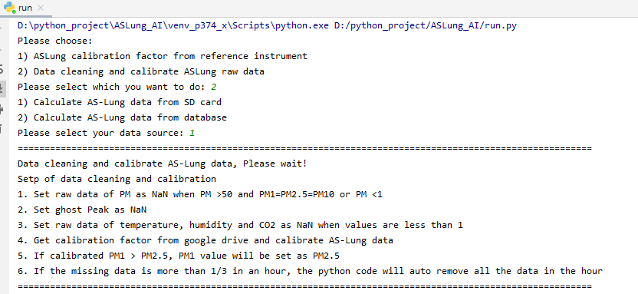
Step of data cleaning will remind again when run the python code

Slide 22
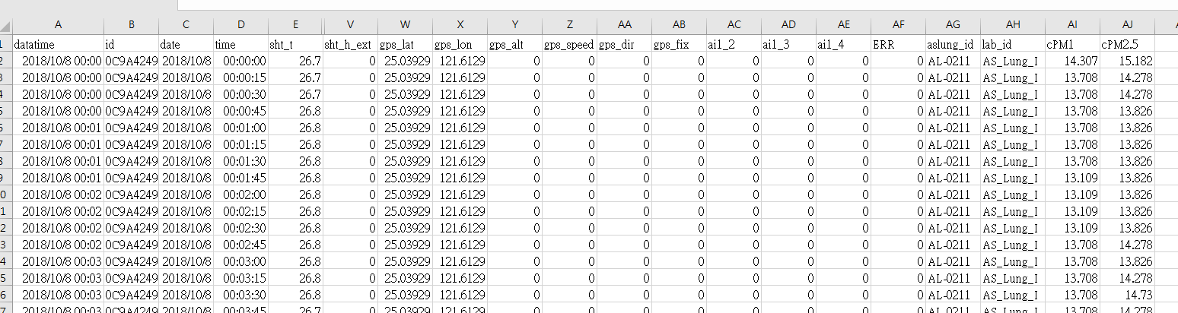
Open CSV file after calibrated
Open the calibrated csv file, AS-Lung ID, lab id , calibrated PM₁ and PM_{2.5} will add in the end
column of the data set

Slide 23
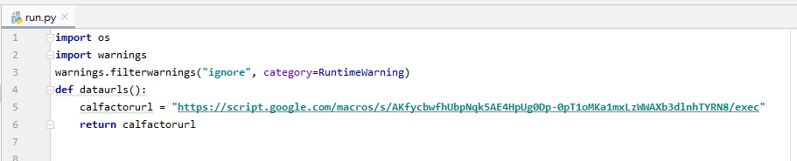
How to update calibration factor API link
1.Open run.py
2.Go to line 5, find calfactorurl = “xxxxxxxxxxx”
3. Past the new link after calfactorurl=“
You can get your google sheet and calibration factor API link from “GoogleSheetAndAPI.xlsx

Slide 24
Thanks!

